Slide 1
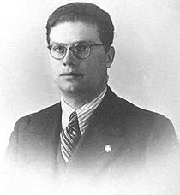
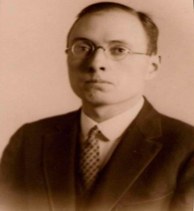
Angular Momentum

Slide 2
What was Angular Momentum Again?
If a particle is confined to going around a sphere:
At any instant the particle is on a particular circle
r
The particle is some distance from the origin, r
The particle has angular momentum, L = r × p
The particle or mass m has some velocity, v and momentum p
v

Slide 3
What was Angular Momentum Again?
So a particle going around in a circle (at any instant) has angular momentum L:
L = r × p
Determine L’s direction from the “right hand rule”
p
r

Slide 4
What was Angular Momentum Again?
L like any 3D vector has 3 components:
L_{x} : projection of L on a x-axis
L_{y} : projection of L on a y-axis
L_{z} : projection of L on a z-axis
L = r × p
z
p
x
r
y

Slide 5
What was Angular Momentum Again?
Picking up L and moving it over to the origin:
L = r × p
L = r × p
z
p
x
r
y

Slide 6
What was Angular Momentum Again?
Picking up L and moving it over to the origin:
L = r × p
z
Rotate
x
y

Slide 7
What was Angular Momentum Again?
And re-orienting:
Rotate
z
L = r × p
x
y

Slide 8
What was Angular Momentum Again?
And re-orienting:
L = r × p
z
x
y
Now we’re in a viewpoint that will be convenient to analyse

Slide 9
Angular Momentum Operator
L is important to us because electrons are constantly changing direction (turning) when they are confined to atoms and molecules
L is a vector operator in quantum mechanics
L_{x} : operator for projection of L on a x-axis
L_{y} : operator for projection of L on a y-axis
L_{z} : operator for projection of L on a z-axis

Slide 10
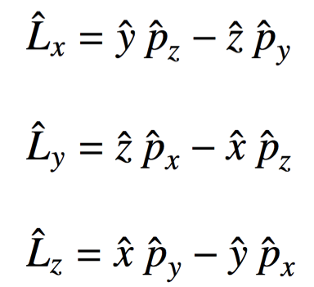
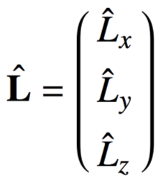
Angular Momentum Operator
Just for concreteness L is written in terms of position and momentum operators as:
with

Slide 11
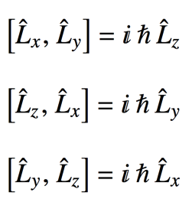
Angular Momentum Operators
Ideally we’d like to know L BUT…
One day this will be a lab…
L_{x} , L_{y} and L_{z} don’t commute!
By Heisenberg, we can’t measure them simultaneously, so we can’t know exactly where and what L is!

Slide 12
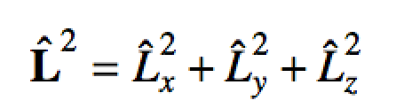
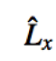
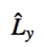
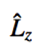
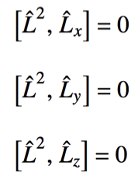
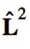
Angular Momentum Operators
does commute with each of
, and individually
is the length of L squared.
has the simplest mathematical form
So let’s pick the z-axis as our “reference” axis

Slide 13
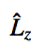
Angular Momentum Operators
So we’ve decided that we will use and as a substitute for
Because we can simultaneously measure:
L² the length of L squared
L_{z} the projection of L on the z-axis
BUT we can’t know L_{x}, L_{y} and L_{z} simultaneously!
We’ve chosen to know only L_{z} (and L²)
L
z
x
L_{z}
y
L_{y}
L_{x}

Slide 14
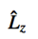
Angular Momentum Operators
So we’ve decided that we will use and as a substitute for
Because we can simultaneously measure:
L² the length of L squared
L_{z} the projection of L on the z-axis
For different L²’s we’ll have different L_{z}’s
z
L
x
L_{z}
So what are the possible
and eigenvalues and what are their eigen-functions?
can be anywhere in a cone for a given L_{z}
y

Slide 15
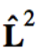
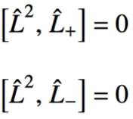
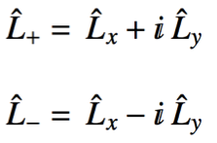
Angular Momentum Eigen-System
Operators that commute have the same eigenfunctions
and commute so they have the same eigenfunctions
Using the commutation relations on the previous slides along with:
we’d find….
One day this will be a lab too…

Slide 16
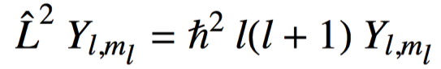
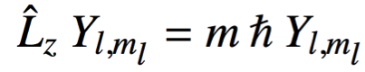
Angular Momentum Eigen-System
Eigenfunctions Y, called: Spherical Harmonics
l = {0,1,2,3,….} angular momentum quantum number
m_{l} = {-l, …, 0, …, l} magnetic quantum number

Slide 17
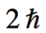
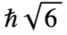
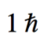
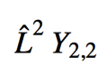
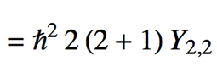
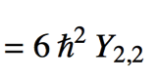
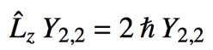
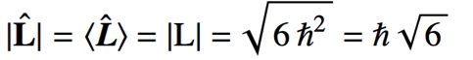
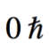
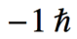
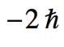
Angular Momentum Vector Diagrams
z
Say l = 2
then m ={-2, -1, 0, 1, 2}
For m =2
For m =2

Slide 18
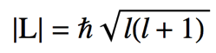
Angular Momentum Vector Diagrams
z
Take home messages:
The magnitude (length) of angular momentum is quantized:
Angular momentum can only point in certain directions:
Dictated by l and m

Slide 19
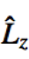
Angular Momentum Eigenfunctions
The explicit form of and is best expressed in spherical polar coordinates:
z
For now, our particle is on a sphere and r is constant
θ
r
y
φ
x
We won’t actually formulate these operators (they are too messy!), but their wave functions Y, will be in terms of θ and φ instead of x, y and z:
Y_{l,m}(θ,φ) = Θ_{l,m} (θ) Φ_{m} (φ)

Slide 20
FIX BELOW PICTURES TO BE THE 2D spherical harmonics and NOT the 3D ones
Use python??

Slide 21
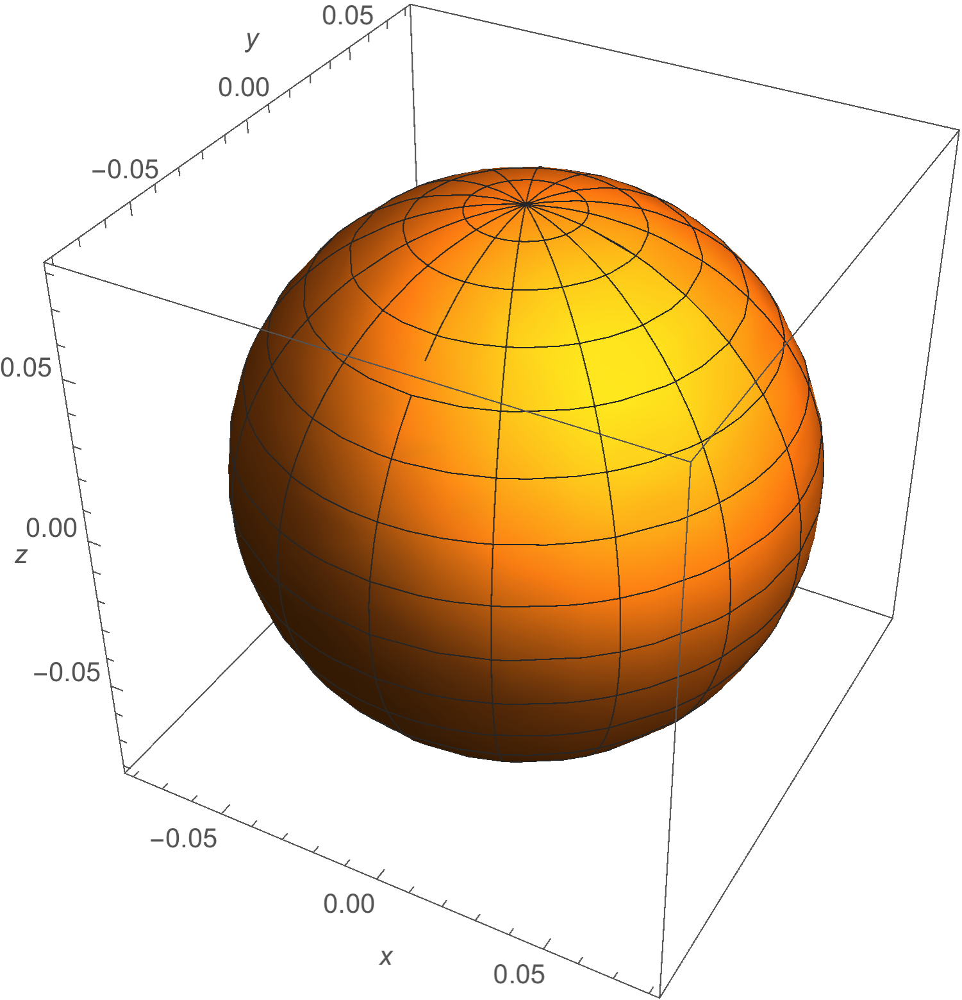
Angular Momentum Eigenfunctions
l = 0, m_{l} = 0

Slide 22
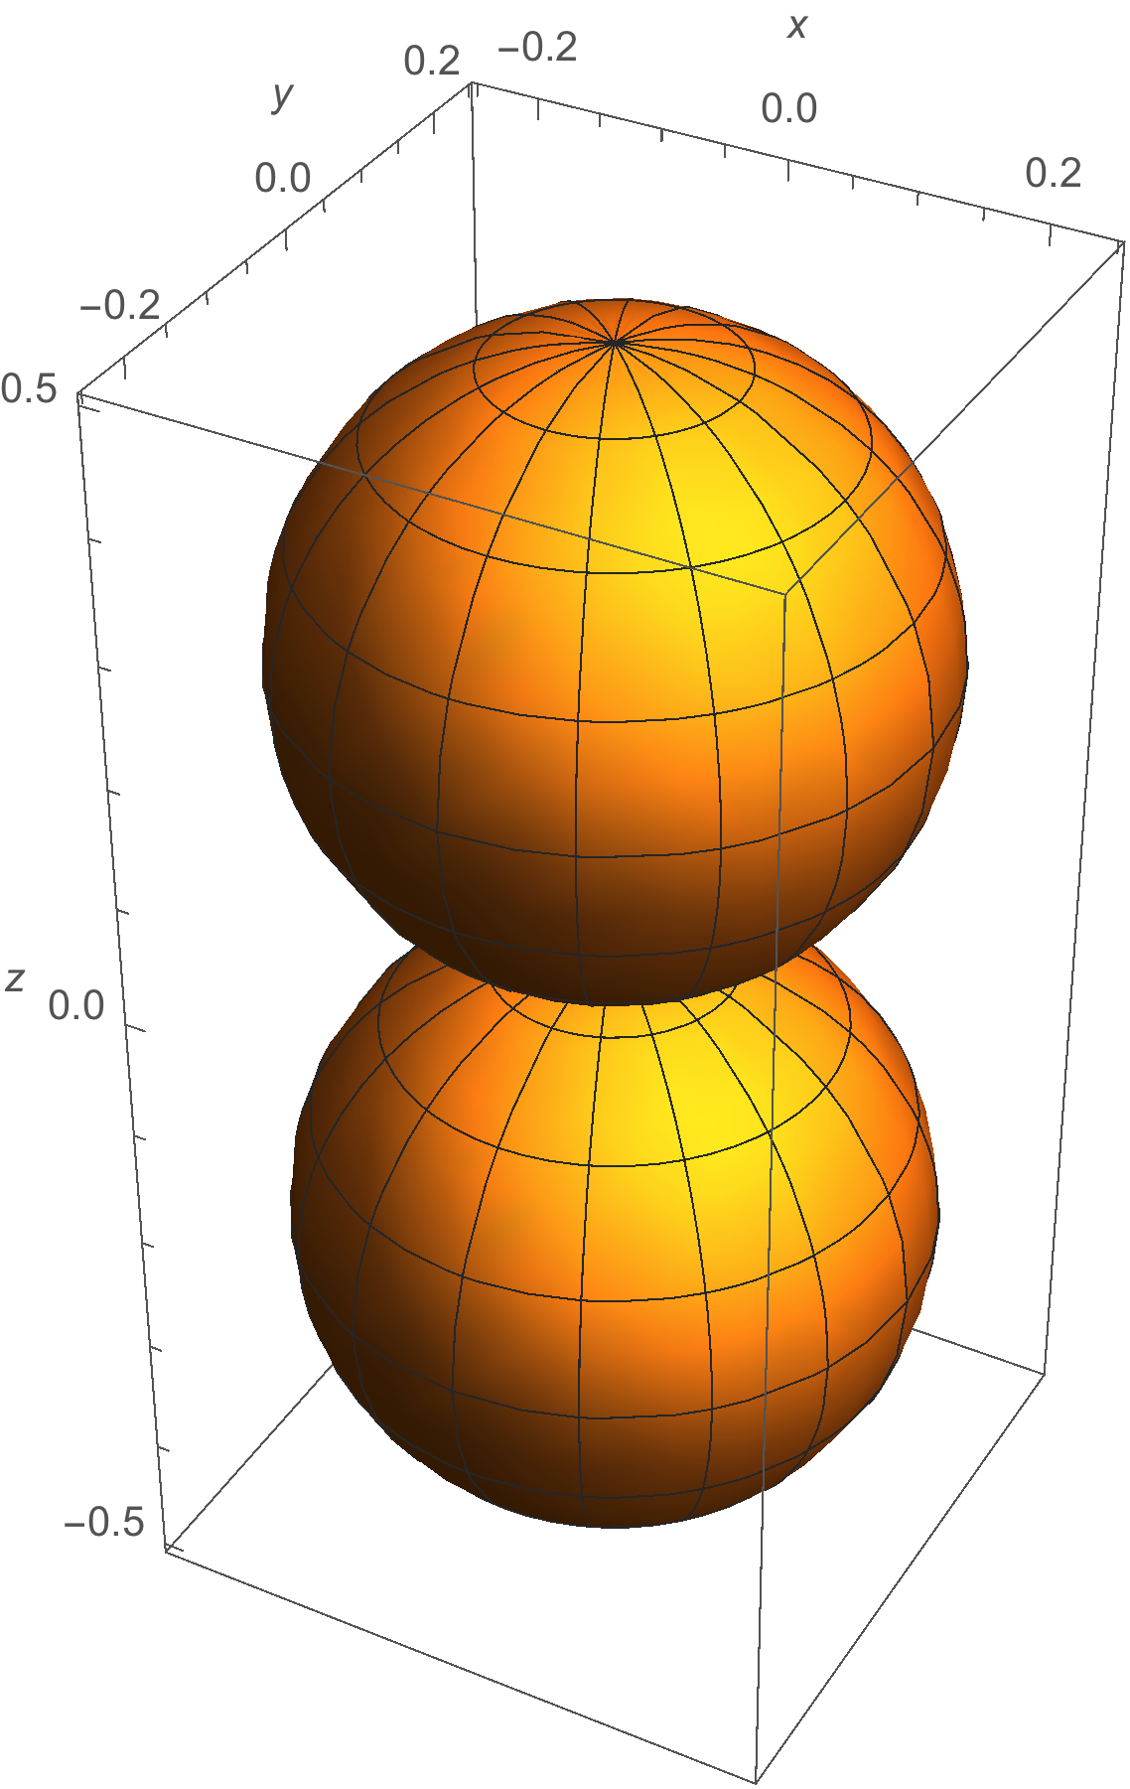
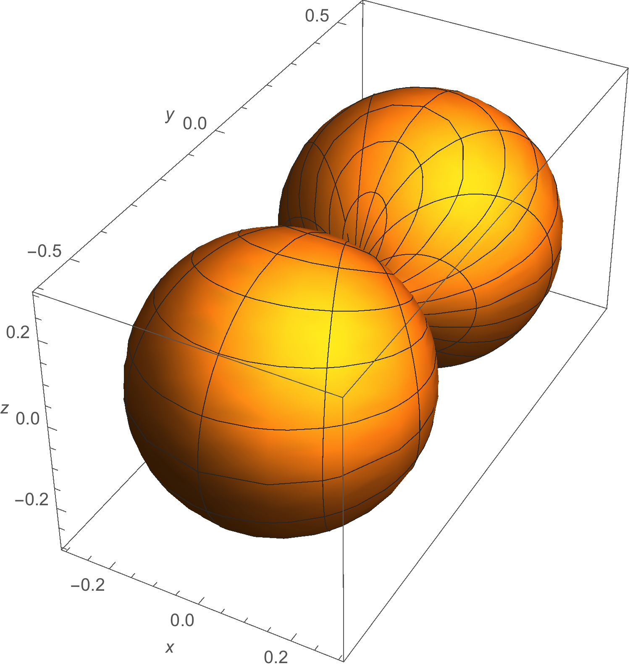
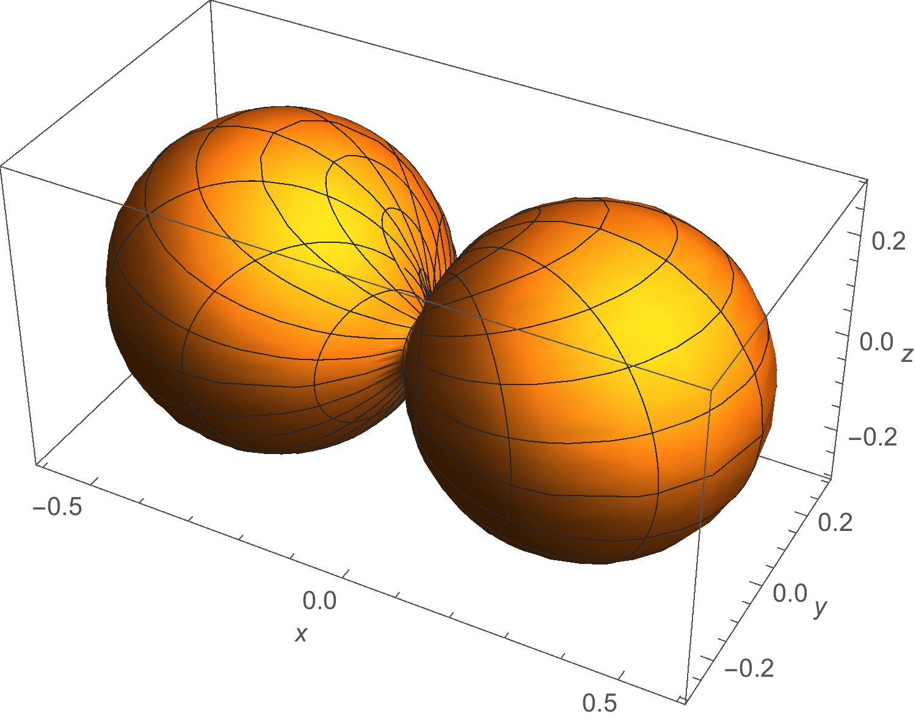
Angular Momentum Eigenfunctions
l = 1 m_{l} ={-1, 0, 1}
Look Familiar?

Slide 23
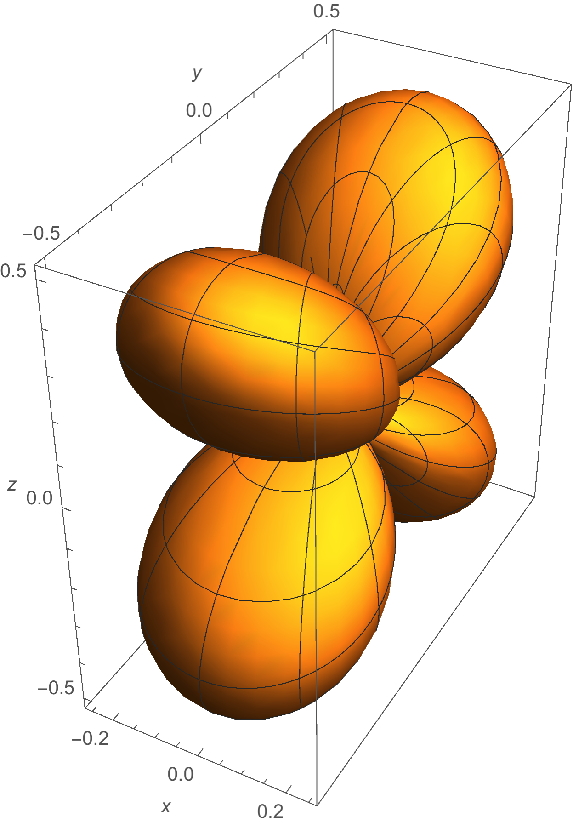
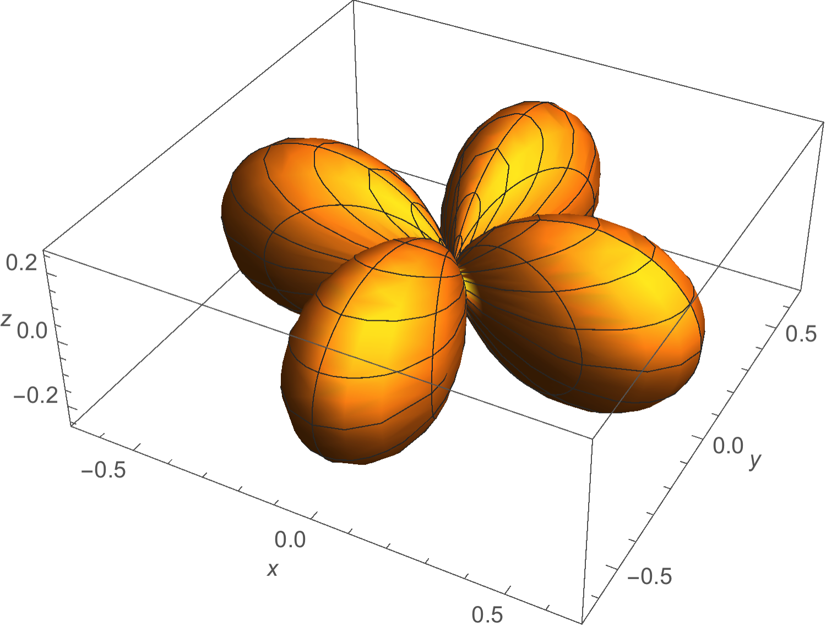
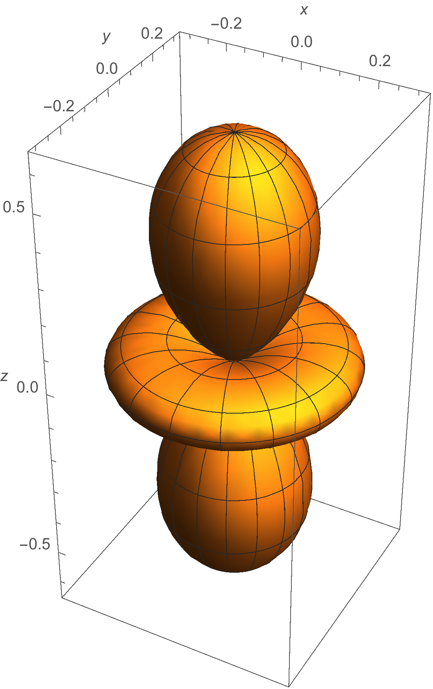
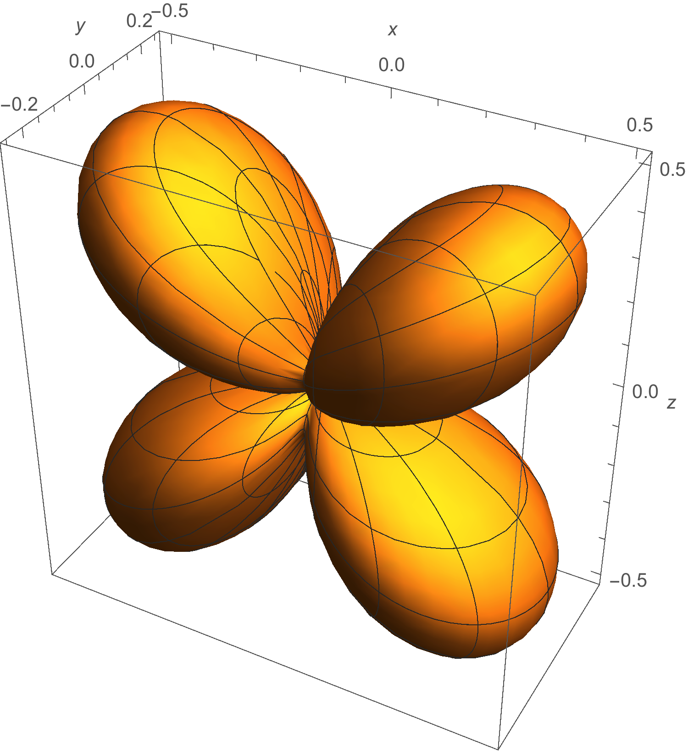
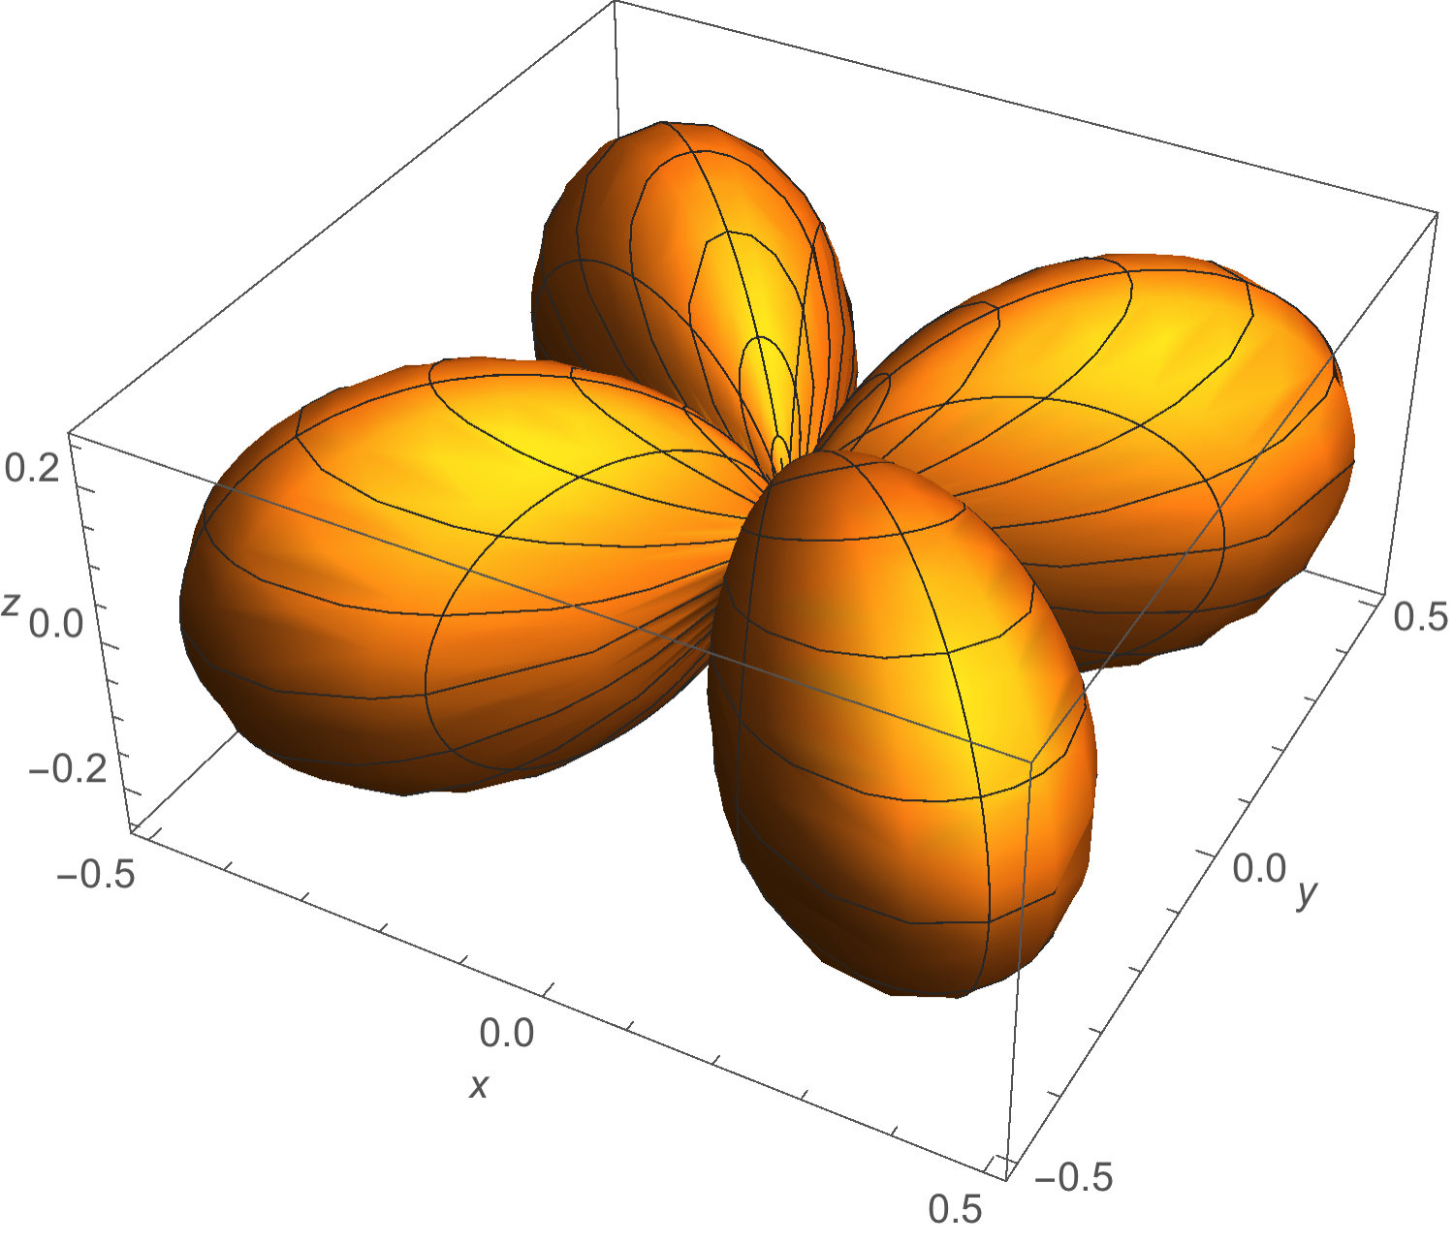
Angular Momentum Eigenfunctions
l = 2 m_{l} ={-2, -1, 0, 1, 2}
Look Familiar?

Slide 24
Particle on a Sphere
r
θ can vary form 0 to π
φ can vary form 0 to 2 π
r is constant

Slide 25
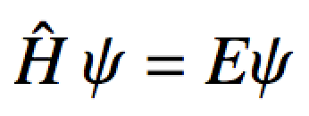
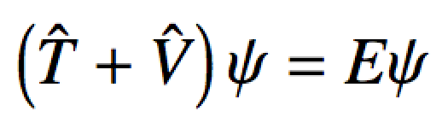
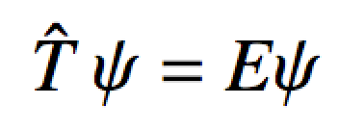
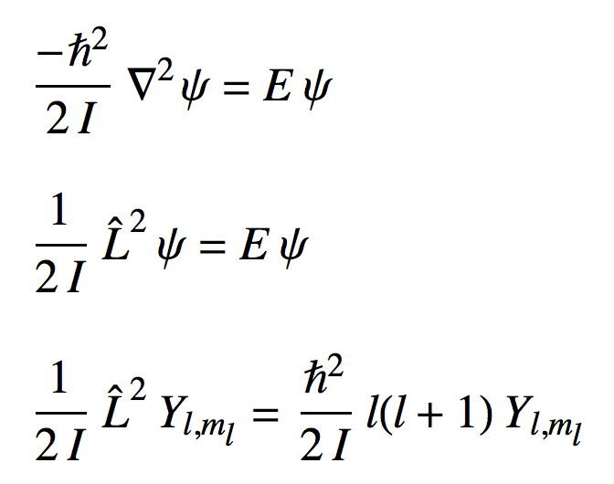
Particle on a Sphere
The Schrodinger equation:
0

Slide 26
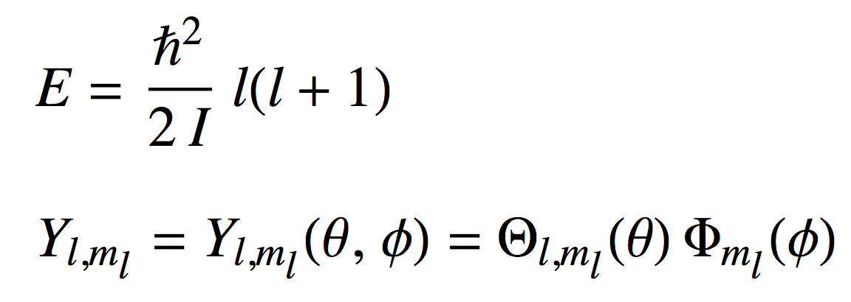
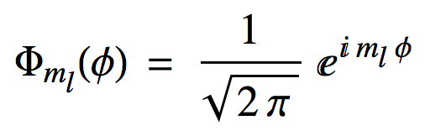
Particle on a Sphere
So for particle on a sphere:
Legendre Polynomials
Spherical harmonics
Energies are 2l + 1 fold degenerate since:
For each l, there are {m_{l}} = 2l + 1 eigenfunctions of the same energy
moment of inertia for a particle on a sphere

Slide 27
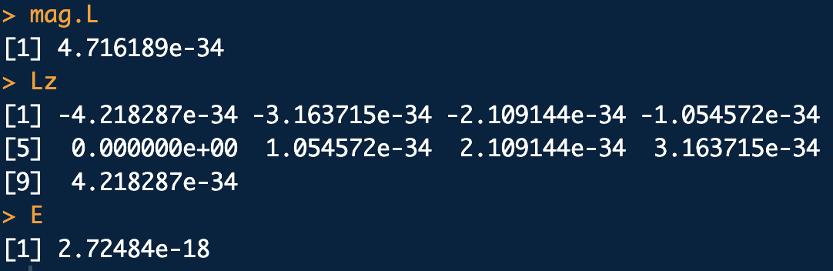
Example
Suppose you have an electron confined to a spherical surface of radius 4a₀ (4 bohr radii) in states with l = 4.
Suppose you measure the magnitude of angular momentum, z-component of angular momentum and energy many times. What are the results, on average, for all the states the electron can be in?
library(che302r)
l <- 4
m <- c(-4, -3, -2, -1, 0, 1, 2, 3, 4)
r <- 4*a0
I <- me*r^2 # Moment of inertia of e-
L2 <- hb^2*l*(l+1) # L^2 eigenvalue (J^2s^2)
# <|L|> avg val of mag ang mom: square root of L^2 eigenvalue, (Js)
mag.L <- sqrt(L2)
mag.L
# <Lz> avg val of ang-mom z-component: Lz eigenvals (Js)
Lz <- m*hb
Lz
# <E> avg val of energy: energy eignenval (J)
E <- L2/(2*I) # hb^2/(2*I) * l*(l+1)
E

